Slide 1
https://www.youtube.com/watch?v=8YYctOTLYJ8

Slide 2
7th Annual SEFH Seminar
September 12, 2020

Slide 3
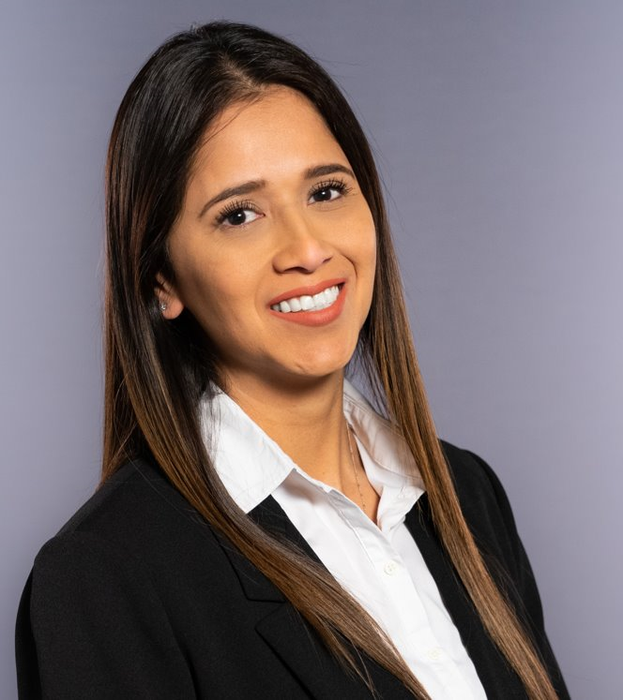
Word from our Sponsor: Chevron
Irene Flores
Public Affairs Representative

Slide 4
Session | Time | Title
1 | 9:30 - 10:30 AM | Scientific Review Committee (Training)
 |  | What a Great Idea! Strategies for Generating Science Fair Research Questions 2.0
2 | 10:35 - 11:35 AM | Part of the Mission: Student Research at Space Center Houston
 |  | The Road to Results: An Introduction to Data Analysis and Visualization
Lunch | 11:40 - 12:40 AM | Meet and Greet with ISEF Alumni
 |  | Hosting a Science Fair (Roundtable)
3 | 12:45 - 1:45PM | Teacher as Mentor During a Pandemic (Roundtable)
 |  | Scienteer Information
 |  | Rocket Judge Online Platform
4 | 1:50 - 2:50 PM | Start a Science Fair Club!
 |  | Judging Matters
Session Schedule

Slide 5
SEFH 2020

Slide 6
Congratulations!
Clear Creek ISD:
VARUN BALAJI (GRADE 8) The Dark Side of Light: Fruit Flies' Plight Seabrook Intermediate School Seabrook, Texas
Conroe ISD:
MADELYN PUZA (GRADE 8) Biodegradability of Starch-Based Bioplastics in an Ocean Environment Knox Junior High School Spring, Texas
Fort Bend ISD:
ANUSHKA AGGARWAL (GRADE 8) PURi—The Water Purification Process Quail Valley Middle School Missouri City, Texas
MADISON BURKE (GRADE 8) PURi—The Water Purification Process Quail Valley Middle School Missouri City, Texas
SANSKRITI MANOHARAN (GRADE 7) A Novel Method to Measure Long-Term Particulate Matter (PM) Accumulation on Ligustrum japonicum 'Texanum' Leaves as an Indicator of Airborne PM Quail Valley Middle School Missouri City, Texas
Home School:
ANNA K. SINGH (GRADE 7) Goldfish and Plant Growth Homeschool Pearland, Texas
Magnolia ISD:
NATALIE ELIZABETH SMITH (GRADE 8) Better Bioleather from a Kombucha Colony Magnolia Junior High School Magnolia, Texas

Slide 7
TXSEF Update
March 7 – Last day for Regions to advance projects
March 11
Student Registration and project submissions due
SRC Approval due by 5:00 pm

Slide 8
SEFH Updates
We're Going Virtual!
Addition of 6th grade projects
15 projects added to overall allotments
Science & Sport Award
Science Fair High School Clubs

Slide 9
Project
Quotas

Slide 10
SEFH Information
29 Jan.
Last day for Districts/Schools to Advance Projects
Student Registration and project submissions due
8 Feb.
SRC Approval due by 5:00 pm
12 Feb.
D&S Approval due by 5:00 pm
13–28 Feb.
Judging
Awards Ceremony
3 Mar.
Student Advancment to TXSEF

Slide 11
SEFH Student Project Submission
7-minute maximum Narrated PowerPoint Slide
Exported as video and hosted on YouTube
PPT will be in lieu of the posterboard
May Include Slide Headers such as: Project Title, Problem/Question, Hypothesis, Variables, Background Research, Materials, Procedure, Data/Observations, Photos, Charts, Graphs, Results, Conclusion
Must Follow all D&S Guidelines: e.g. Works Cited, appropriate photos and photo credits, etc.
Official Abstract
If needed:
Form 1c
Form 7

Slide 12
Session | Time | Title
1 | 9:30 - 10:30 AM | Scientific Review Committee (Training)
 |  | What a Great Idea! Strategies for Generating Science Fair Research Questions 2.0
2 | 10:35 - 11:35 AM | Part of the Mission: Student Research at Space Center Houston
 |  | The Road to Results: An Introduction to Data Analysis and Visualization
Lunch | 11:40 - 12:40 AM | Meet and Greet with ISEF Alumni
 |  | Hosting a Science Fair (Roundtable)
3 | 12:45 - 1:45PM | Teacher as Mentor During a Pandemic (Roundtable)
 |  | Scienteer Information
 |  | Rocket Judge Online Platform
4 | 1:50 - 2:50 PM | Start a Science Fair Club!
 |  | Judging Matters
Session Schedule

