Slide 1
What a great idea! Strategies for Generating Science Fair Research Question 2.0
Alaina Garza, Clear Brook High School
Clear Creek ISD
http://cbsef.weebly.com/

Slide 2
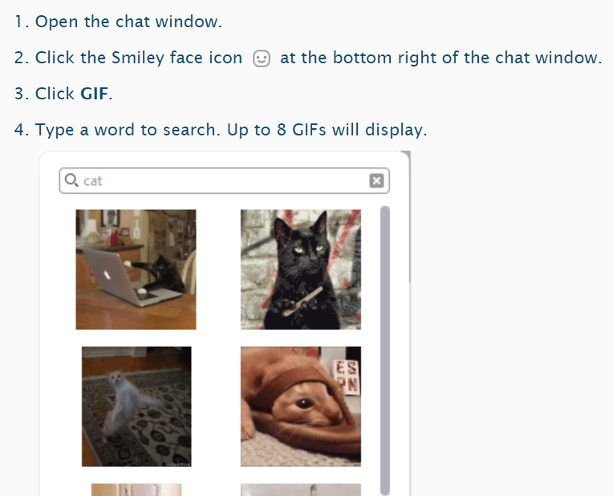
In the chat:
Post two GIFs
one of a topic that you really enjoy
one of a topic that you know a lot about

Slide 3
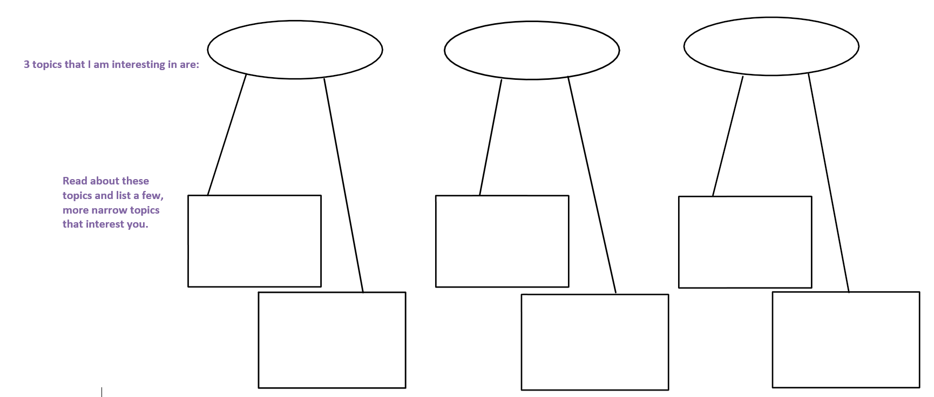

Slide 4
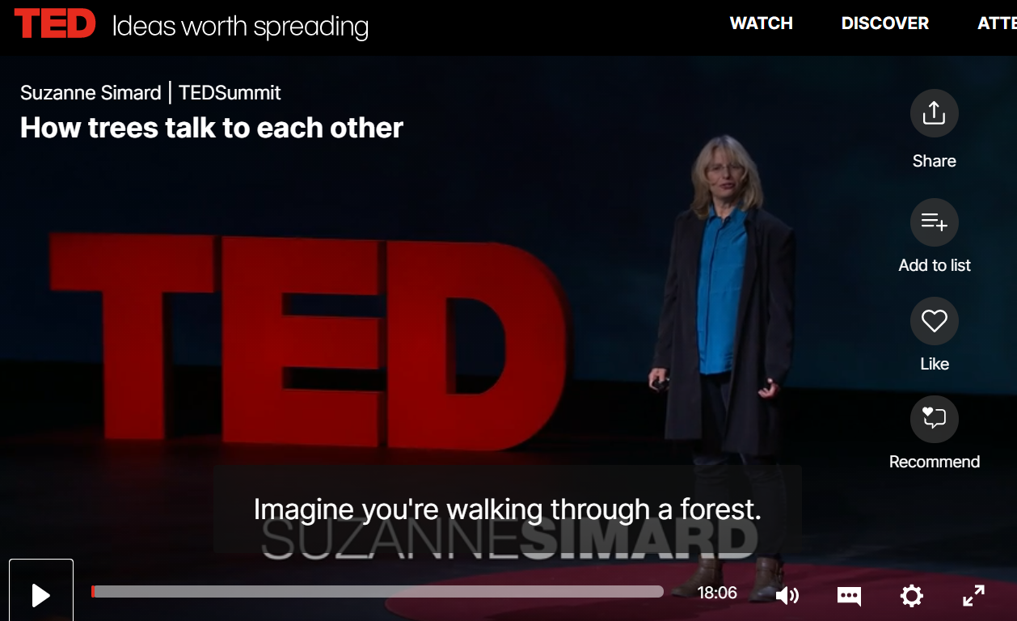

Slide 5
Free Write
Ask yourself questions such as:
What do I know about the topic?
Is there a concern or problem within this topic?
How is this affecting the community (or other stakeholders)?
What resources do I have that I could use to contribute?
Who do I need to talk to or where can I look for more information?

Slide 6
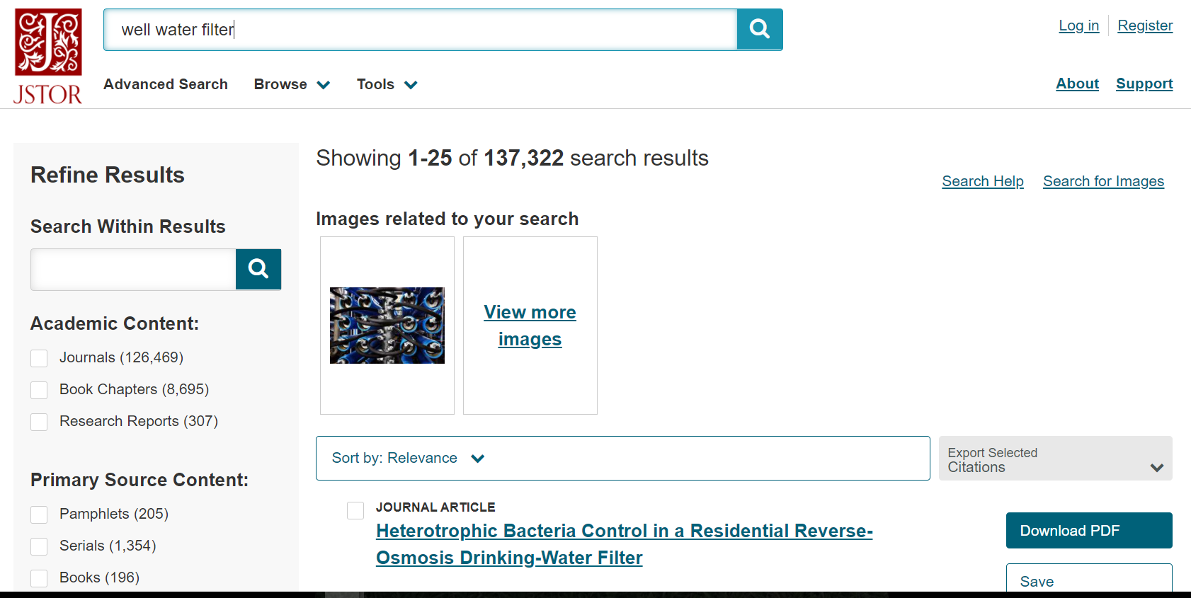

Slide 8
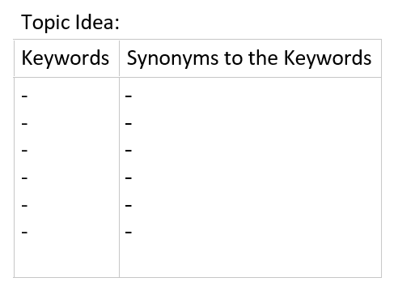
Words to research

Slide 9
Start reading, listening

Slide 10
And watching!

Slide 11
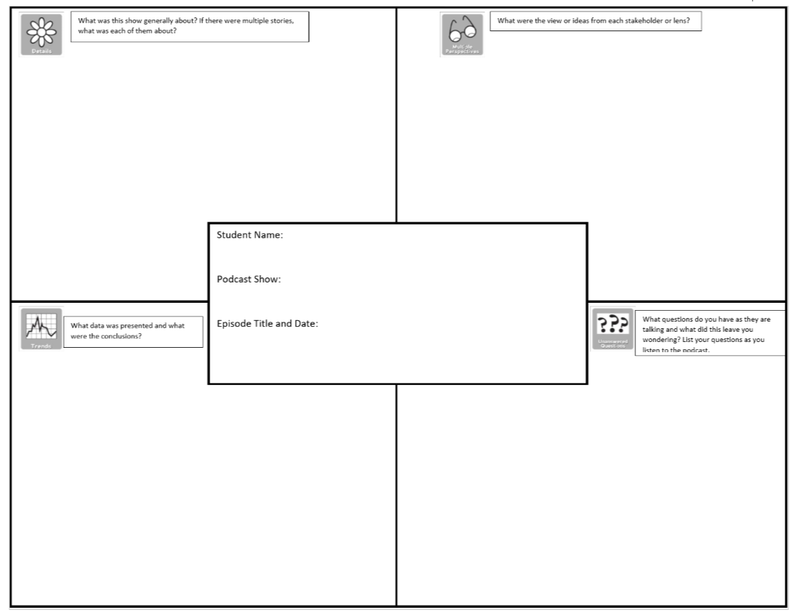

Slide 12
The Sound of discovery
Less like
Eureka!
More like
Hmm, that’s interesting

Slide 13
Challenges of 2020
Staying Home
Lab Access
Virtual Presentations

Slide 14
Tips from isef (ssp)
Choose appropriate model organisms.
Use simple and available technology.
Obtain quantitative data and use statistical analysis.
https://docs.google.com/document/d/1Ceu3OLYO3rcxIZpNIUNtW5eWUr3p3N9Zvoe9hpMCnUU/edit?usp=sharing
Follow your interests, use local resources and ask good questions.
Have a global perspective.
Be a good record keeper.
Reach out to experts.
https://www.societyforscience.org/blog/at-virtual-regeneron-isef-educators-shared-top-tips-for-researching-at-home/

Slide 15
How can I help my students?
Post a List of available resources such as:
Equipment they can check out
Mentors/teachers who are willing to help, as well as what their expertise is.
Locations to find available data.

Slide 16
iNaturalist

Slide 17
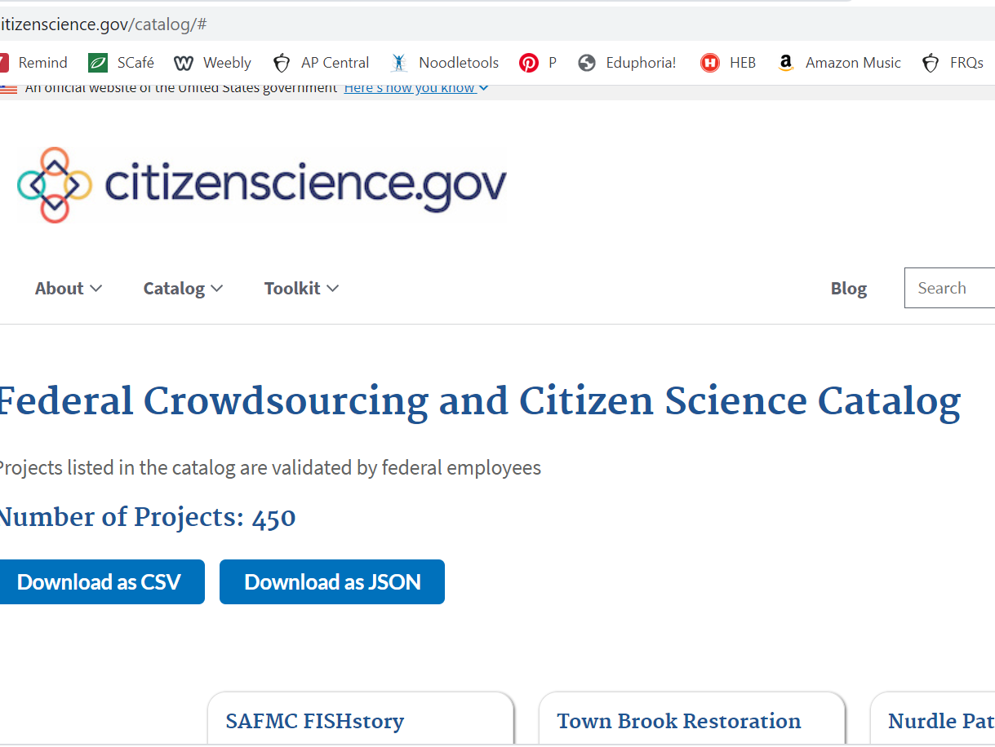
Citizenscience.gov

Slide 18
Data.gov

Slide 19
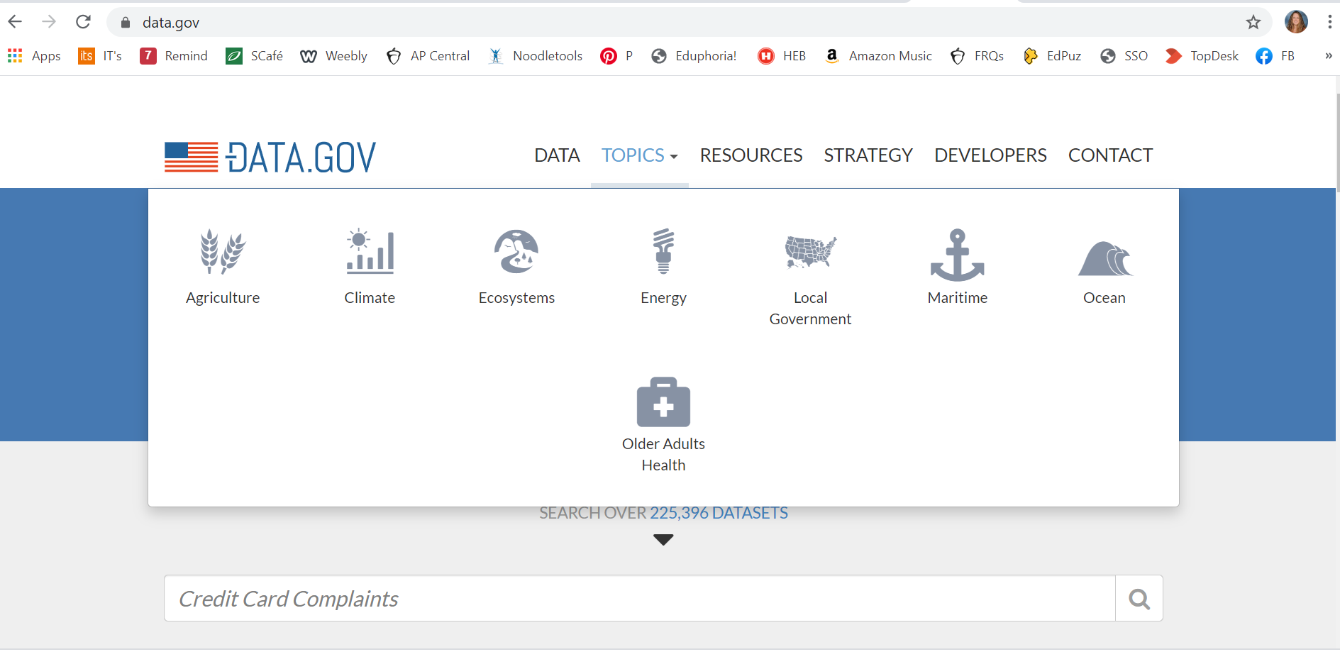
Data.gov

Slide 20
Cdc data and statistics

Slide 21
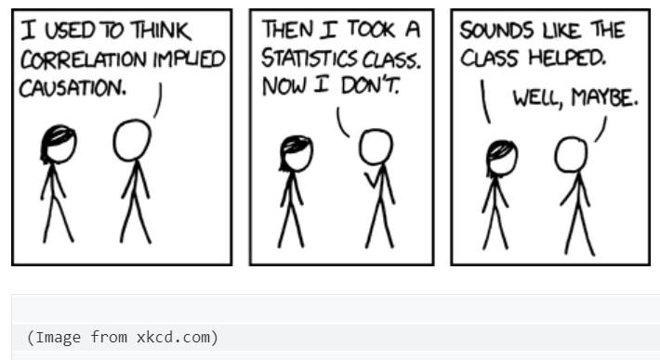
Beware of spurious correlations

Slide 22
Science Friday Sampling Activity

Slide 23
Biomimicry

Slide 24
What is trendy in today’s science fair projects

Slide 25
Resources from ssp

Slide 26
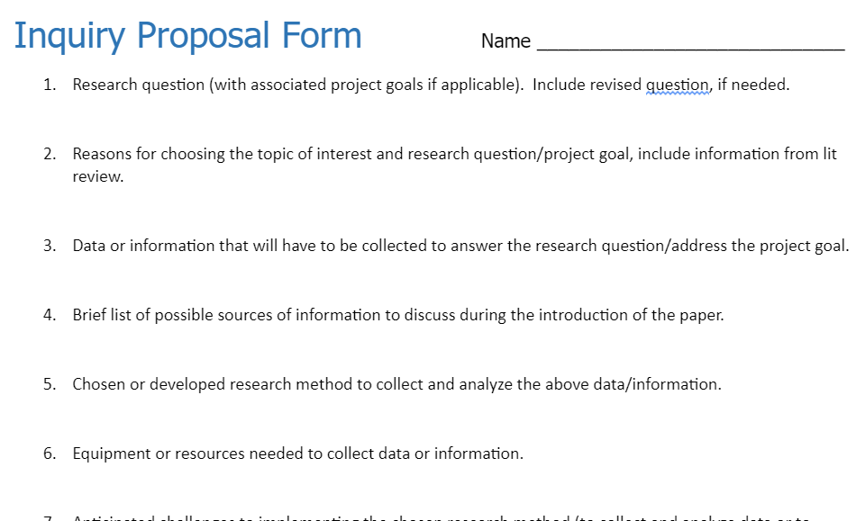
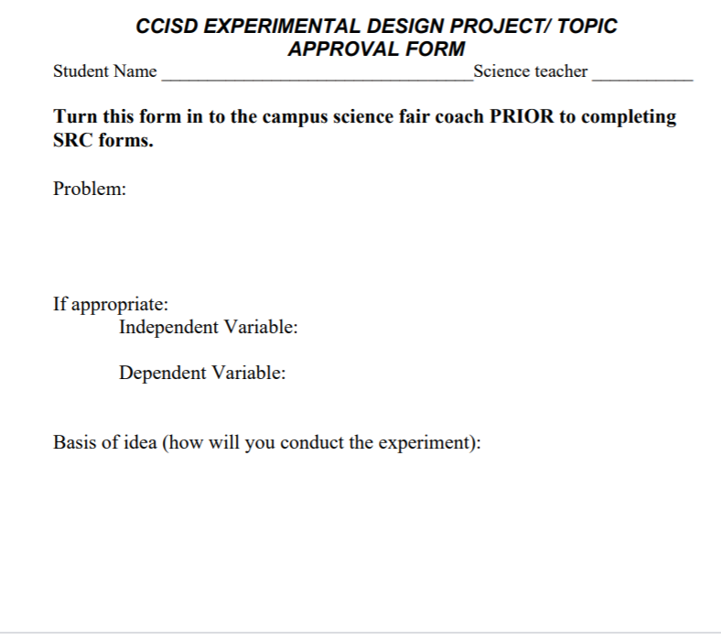
Topic approval forms

Slide 27
Theme for 2020
FLEXIBILITY

Slide 28
Questions?

